Slide 1
Supply Chain Dashboard Integrating Prices, CMI Projects and Carbon Footprints
Ananth V Iyer (Dean and Professor)
Aditya Vedantam (Associate Professor)
Siddanth Dhall (Graduate Student)
Venkatesh Bonta (Graduate Student)
School of Management
University at Buffalo, SUNY
aviyer@buffalo.edu

Slide 2
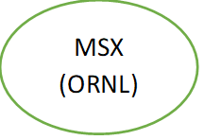
Supply Chain: Three project stages (Example)
Co carbonate (sell)
Co (sell)
EV magnet
Co Carbonate to metal conversion
CeCo magnet
Battery Scrap
Co carbonate (buy)
Co (buy)
Buy prices higher than sell prices due to transaction costs (spread)
Prices fluctuate

Slide 3
Integrated Supply Chain
MSX (ORNL)
CeCo EV magnet
Co carbonate
Co carbonate to Co metal conversion
Co
CeCo magnet
(Ames)
Battery Scrap
Benefit ?
Avoid transaction costs, reduce impact of price variations, capture higher profits

Slide 4
Cobalt Carbonate (Dollars/kg)
Mean Price = $23/kg, Standard Deviation = 9.14

Slide 5
Converting Battery Scrap to Cobalt Carbonate
Input Battery Scrap
Preprocessing
MSX process (ORNL)
Cobalt Carbonate
Placeholder values used (actual current costs with project owner)
Largest cost fraction is raw material costs (fixed costs impact small)
Using scrap cost, preprocessing cost and processing cost of 17.8 and the cobalt carbonate mean and std deviation as 23 and 9.14
Assume that the cobalt carbonate sell price you get is 20% below market mean of 16.66 and stdev of 8.58
The average profit associated with a processing an output volume of 50,000 kgs of Cobalt Carbonate is
-57000 (16.66-17.8)*50000

Slide 6
Environmental Impact:Pathways
Pathway 1
Pathway 2
Scrap Collection
Mining & Extraction of Cerium
Mining & Extraction of Cobalt
MSX (cobalt oxide as input & cobalt as output
Metallization
Metallization
CeCo Magnet Manufacturing
CeCo Magnet Manufacturing
CMI Research Project

Slide 7
MSX Process
Input
Output
MSX
LIB Scrap
Chemicals + Other Components
Highly pure cobalt Carbonate
Lithium
Manganese
Nickel
+
+
Sulfuric Acid
Ammonium Hydroxide
Sodium Hydroxide
Sodium Acetate
Acetic Acid(Extractant)
Tributyl Phosphate(Organic Solvent)
Electricity
Membrane(polypropylene hollow fibers)
CMI Research Project

Slide 8
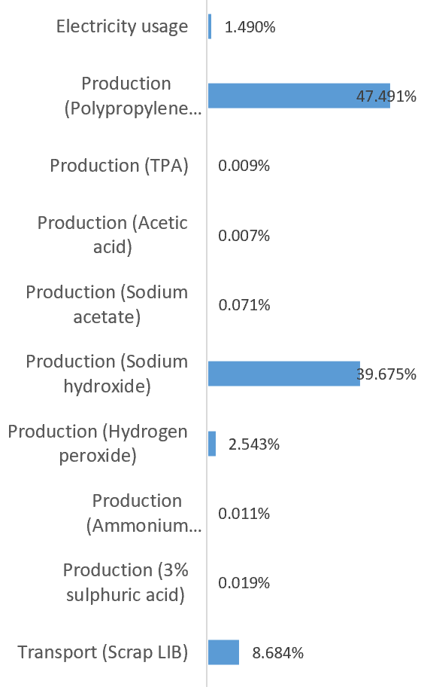
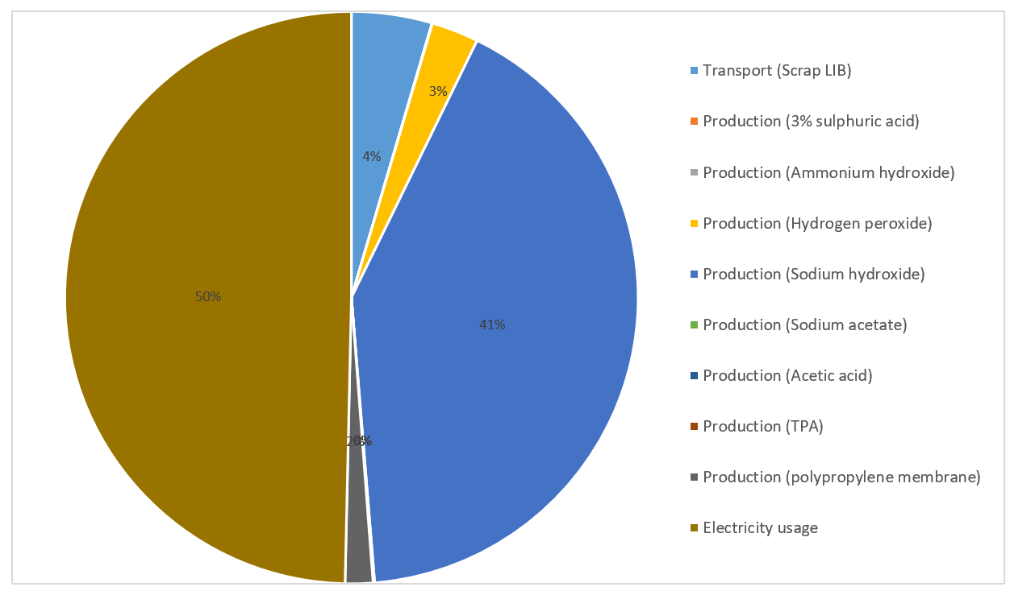
Emission Share
Electricity Usage & Production of Sodium Hydroxide are the biggest contributors to emission in MSX process
Transport of Scrap accounts for less than 10% of the emissions
CMI Research Project

Slide 9
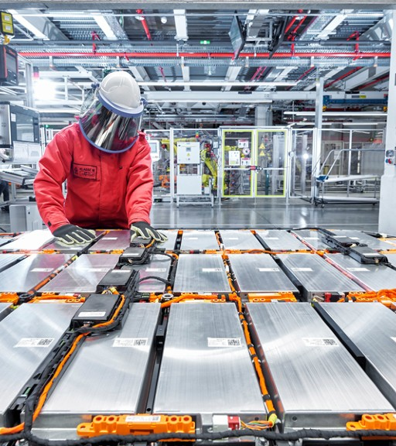

CMI Research Project
Generating Cobalt carbonate from scrap LIBs is has a lower footprint than cobalt sourced from mining
CMI Research Project

Slide 10
Critical Materials Research Project
Environment & Economic Analysis Dashboard
User Manual

Slide 11
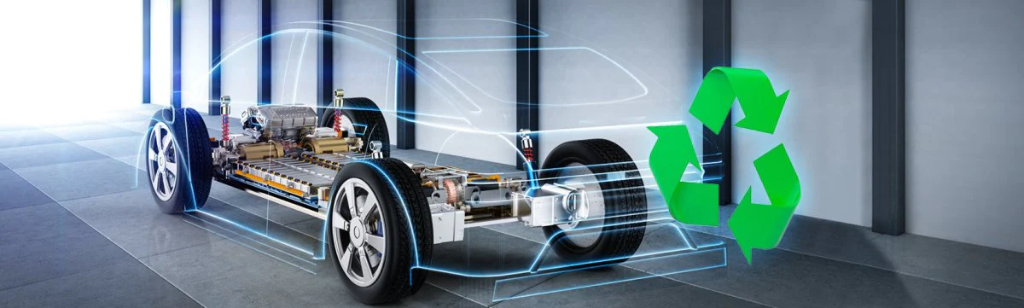
Environment & Economic Analysis Dashboard
User Manual
Overview
The dashboard provided offers a comprehensive and powerful tool for analyzing and comparing the profitability of different projects. It allows users to input various variables such as input costs, conversion costs, market prices, and demand levels for each project. The dashboard then calculates and visualizes key metrics such as expected profit, cost components, and emission levels. By providing a holistic view of the projects and enabling scenario analysis, the dashboard empowers users to make informed decisions regarding project selection and optimization. It serves as a valuable resource for CMI stakeholders, enabling them to identify the most profitable projects and understand the environmental impact.
1

Slide 12
Environment & Economic Analysis Dashboard
User Manual
Overall View
2

Slide 13
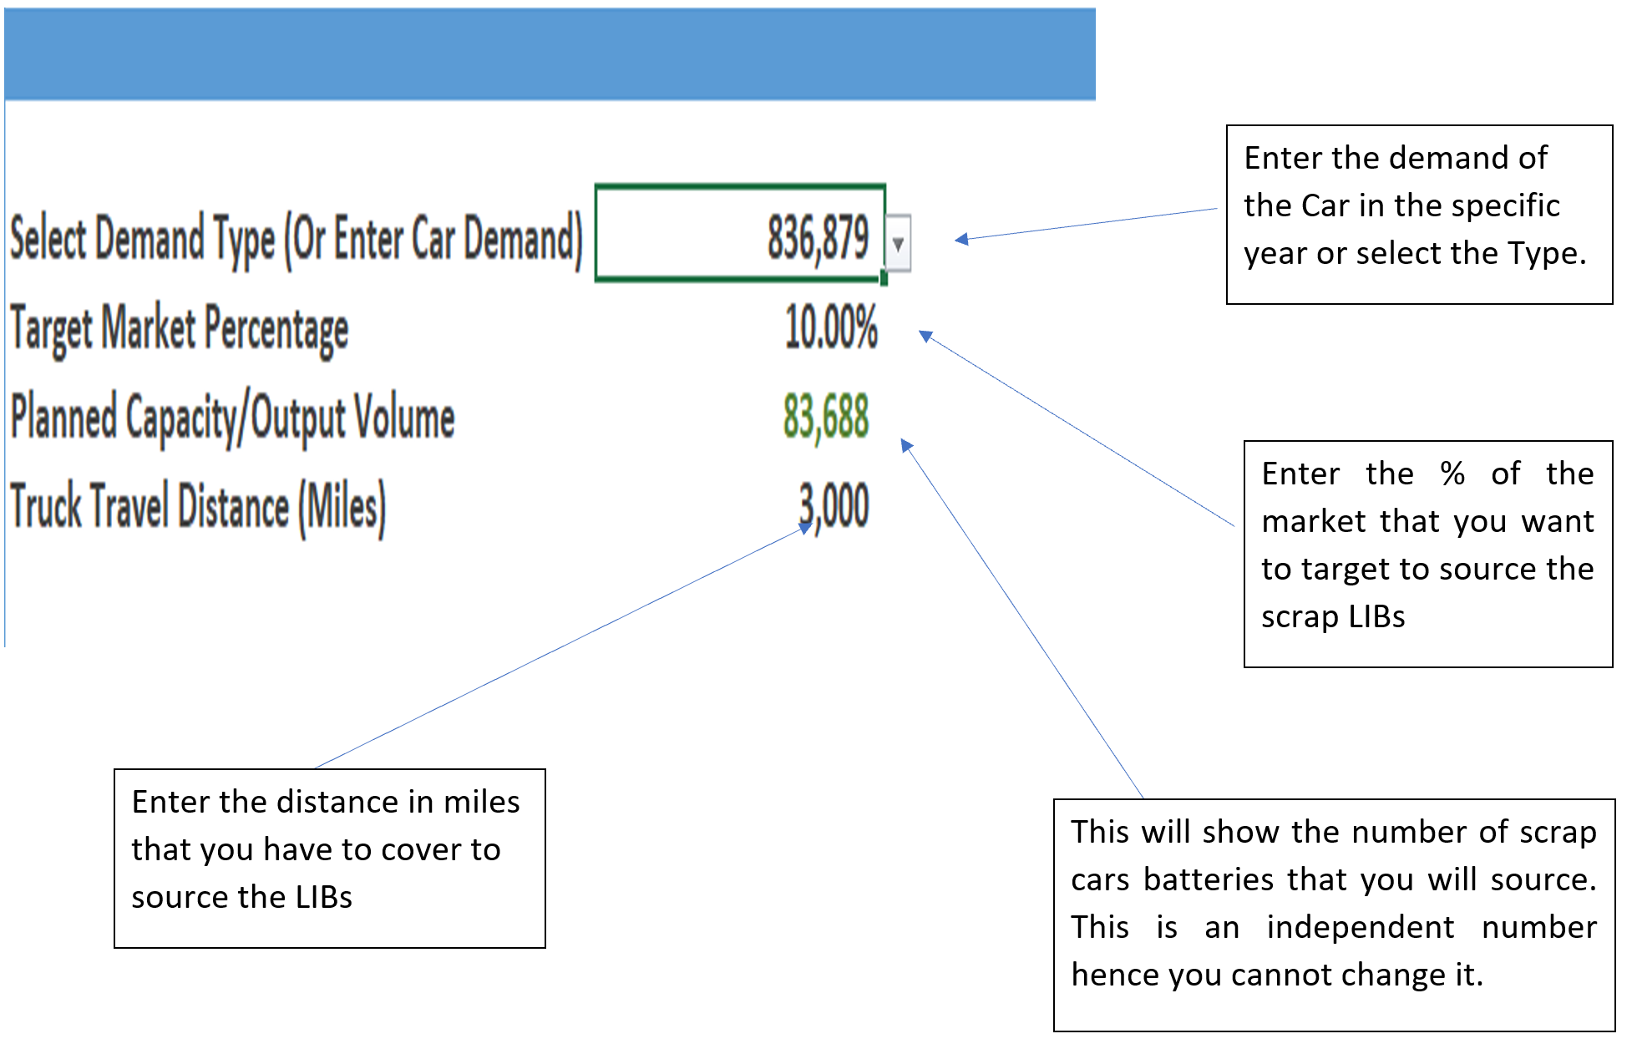
Environment & Economic Analysis Dashboard
User Manual
Demand Inputs
3

Slide 14
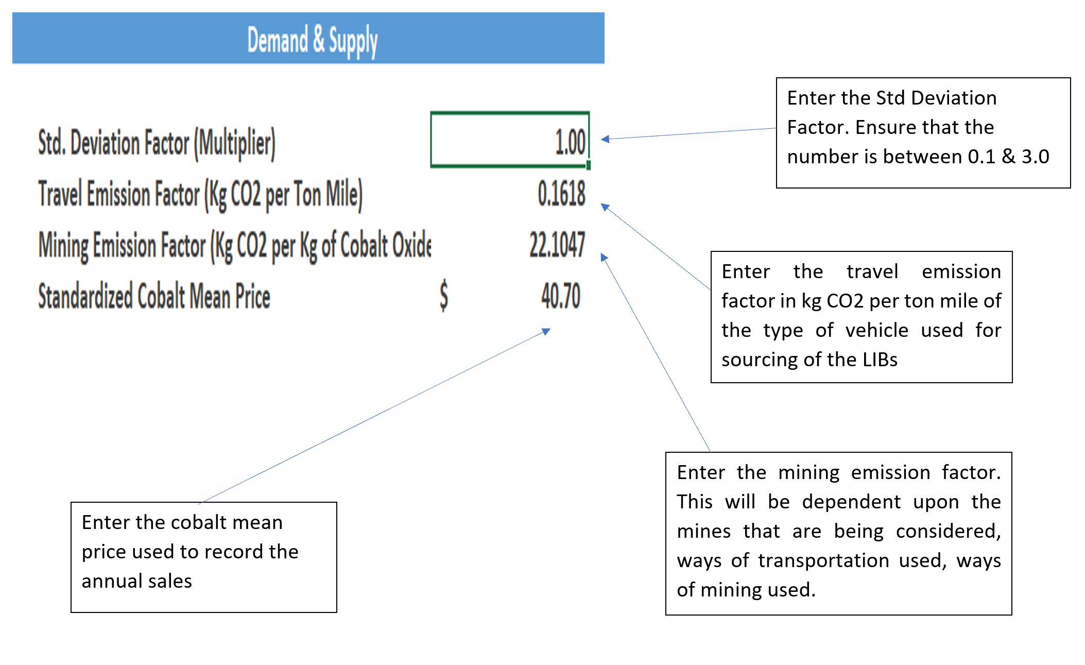
Environment & Economic Analysis Dashboard
User Manual
Standard Factors
4

Slide 15
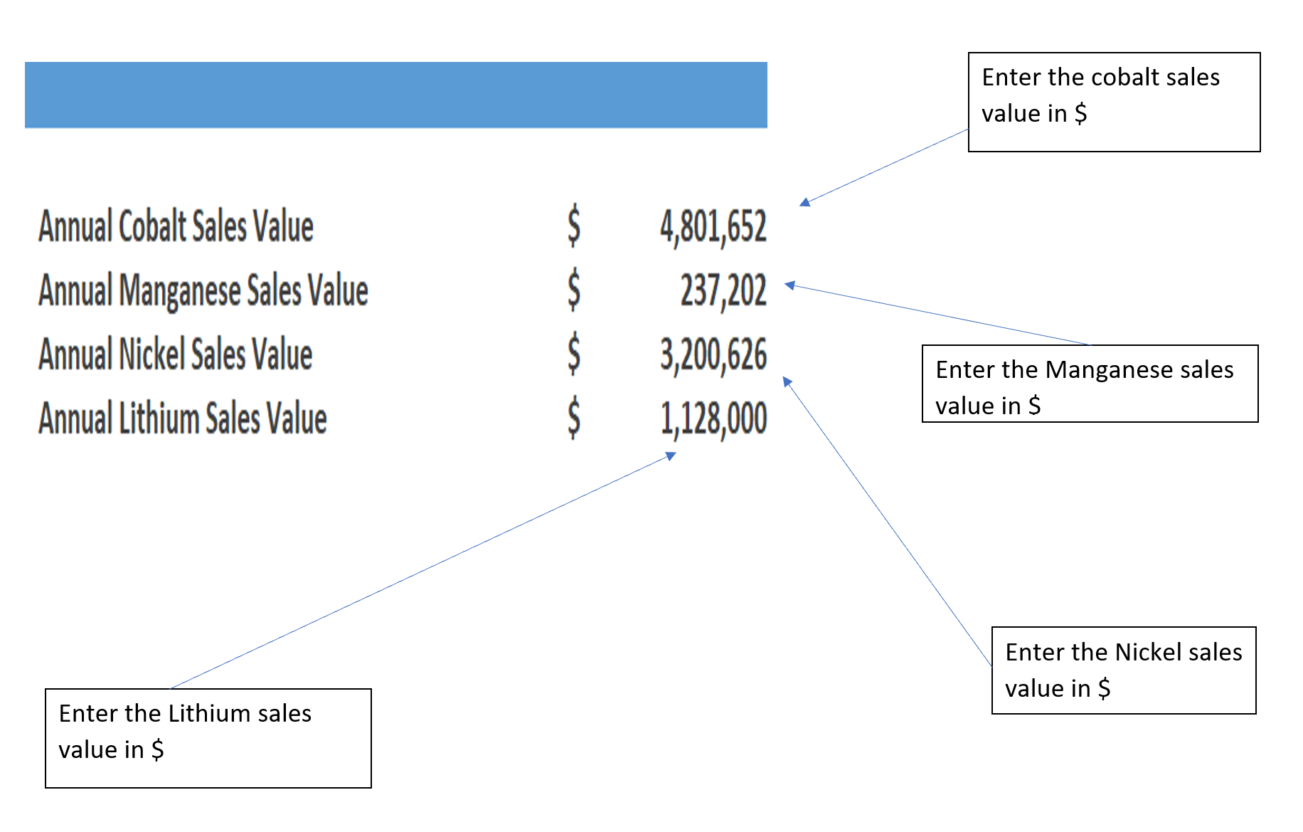
Environment & Economic Analysis Dashboard
User Manual
Annual Sales Inputs
5

Slide 16
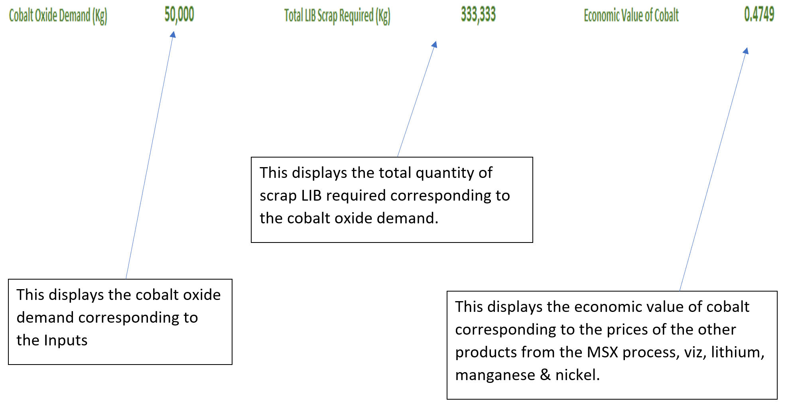
Environment & Economic Analysis Dashboard
User Manual
Supply Output
Cobalt Carbonate Demand (Kg) 79,333
This displays the cobalt carbonate demand in kilograms
6

Slide 17
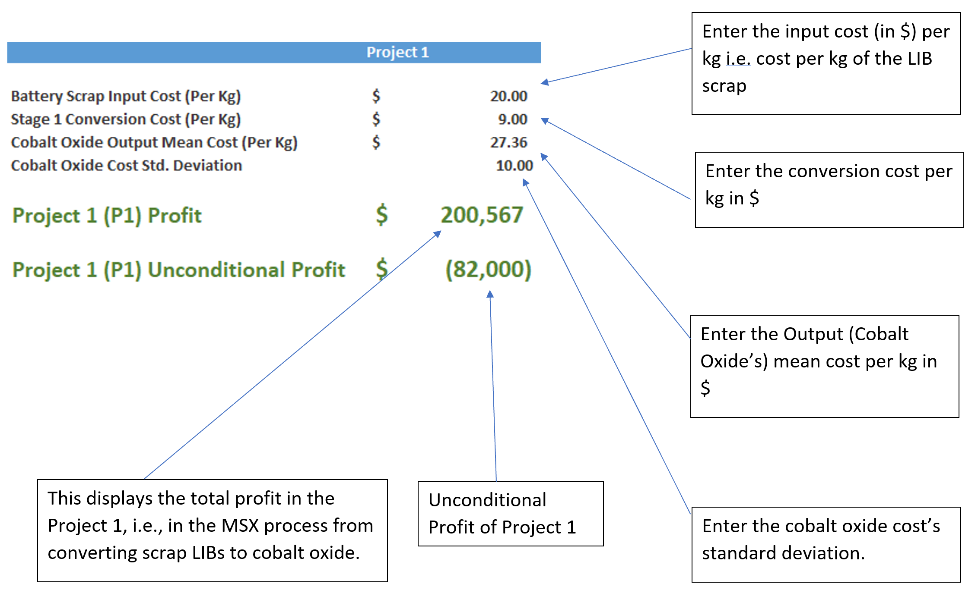
Environment & Economic Analysis Dashboard
User Manual
Project 1 Details
Cobalt Carbonate
Cobalt Carbonate
Enter the cobalt carbonate price’s standard deviation
Cobalt Carbonate
7

Slide 18
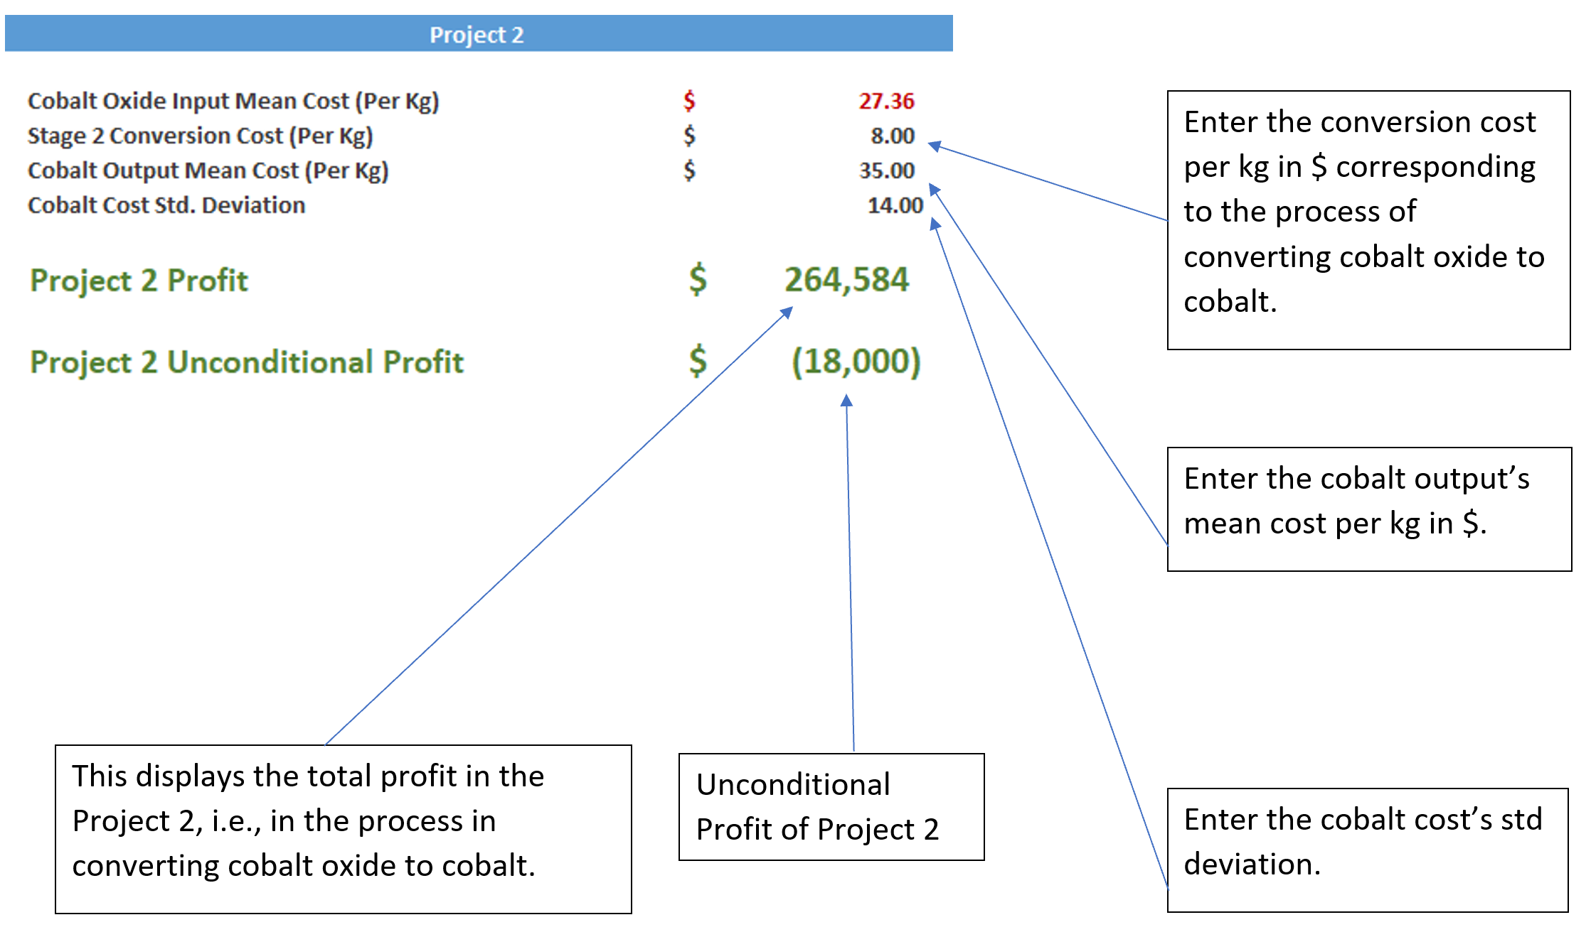
Environment & Economic Analysis Dashboard
User Manual
Project 2 Details
Cobalt Carbonate
to converting cobalt carbonate to cobalt
8

Slide 19
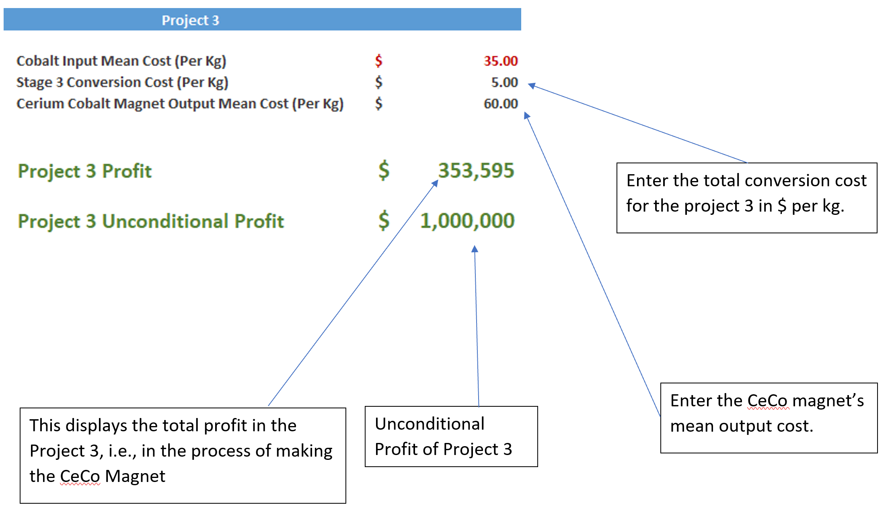
Environment & Economic Analysis Dashboard
User Manual
Project 3 Details
9

Slide 20
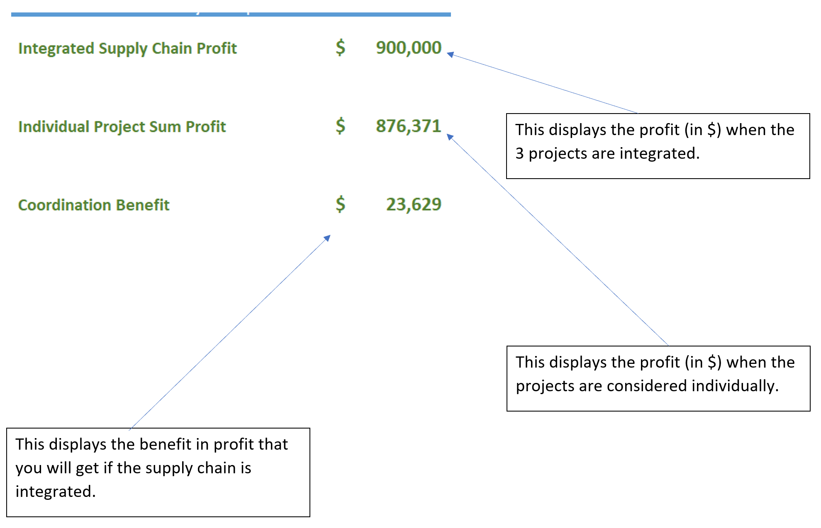
Environment & Economic Analysis Dashboard
User Manual
Profitability
11

Slide 21
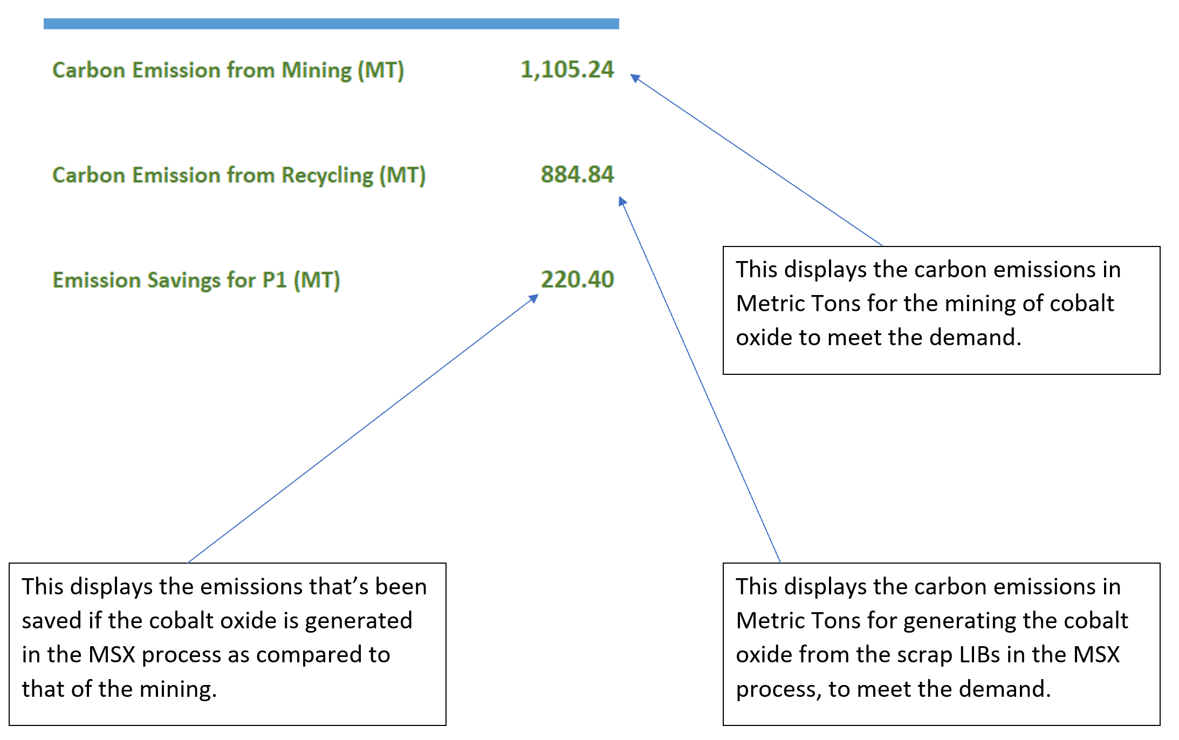
Environment & Economic Analysis Dashboard
User Manual
Emissions
This displays the carbon emissions in metric tons for the mining of cobalt carbonate to meet the demand
This displays the emissions that have been avoided if the cobalt carbonate is generated in the MSX process as compared to mining it.
This displays the carbon emissions in metric tons from generating the cobalt carbonate from the scrap LIBs in the MSX process to meet the demand
12

Slide 22
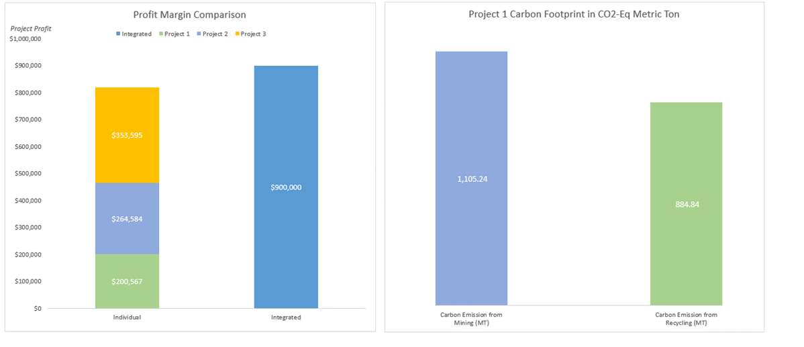
Environment & Economic Analysis Dashboard
User Manual
Graph Section 1
The profit chart showcases a comparison between the individual project profits (presented as a stacked bar chart of the three projects) and the profit of the integrated supply chain (displayed as a separate bar). This graph enables users to evaluate the profitability of each project and assess the overall profitability of the integrated supply chain. By visually comparing the heights of the bars, users can identify the most profitable approach and gain insights into the financial benefits of integration.
The emission comparison bar chart illustrates the emissions generated from mining and recycling. This graph visually presents the environmental impact of the two processes, allowing users to compare and contrast the emission levels. By analyzing the heights of the bars, users can assess the relative environmental sustainability of mining and recycling and consider the implications for their decision-making.
13

Slide 23
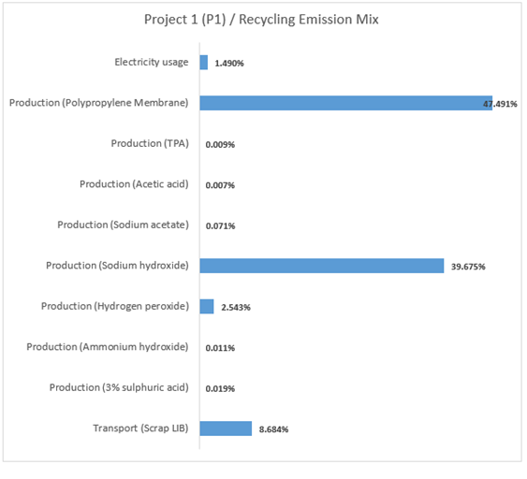
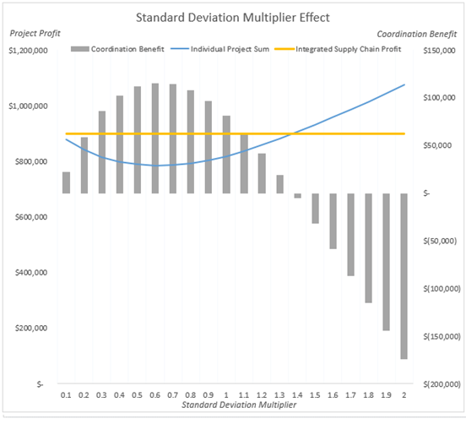
Environment & Economic Analysis Dashboard
User Manual
Graph Section 2
The effect of change in standard deviation line chart examines the impact of varying standard deviations of cobalt and cobalt oxide prices on the individual project sum, the integrated supply chain, and the contribution benefit between the two. This chart enables users to understand how changes in price volatility influence the financial outcomes and coordination benefits of different approaches. By observing the trends of the lines, users can make informed decisions based on their risk tolerance and desired financial outcomes.
The bar chart measuring the emission mix for recycling cobalt oxide provides insights into the distribution of emissions from different sources in the recycling process. This graph allows users to identify the major contributors to emissions, such as electricity, sodium hydroxide production, and other production-related activities. By analyzing the heights of the bars, users can understand the environmental hotspots within the recycling process and explore potential areas for emission reduction and sustainability improvements.
14

Slide 24
Critical Materials Research Project
Environment & Economic Analysis Dashboard
User Manual
Thank you!

